Slide 1
Electric Vehicle Analysis
File created on: 18-01-2025 00:39:45

Slide 2
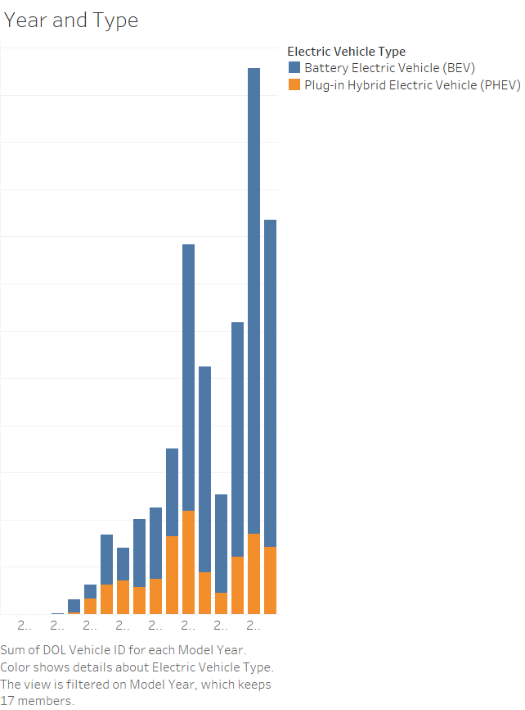

Slide 3
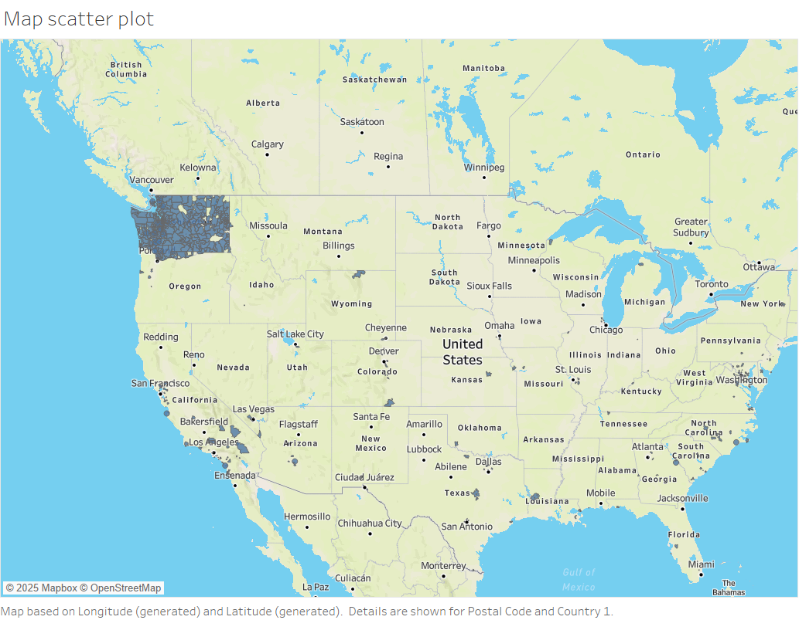

Slide 4


Slide 5
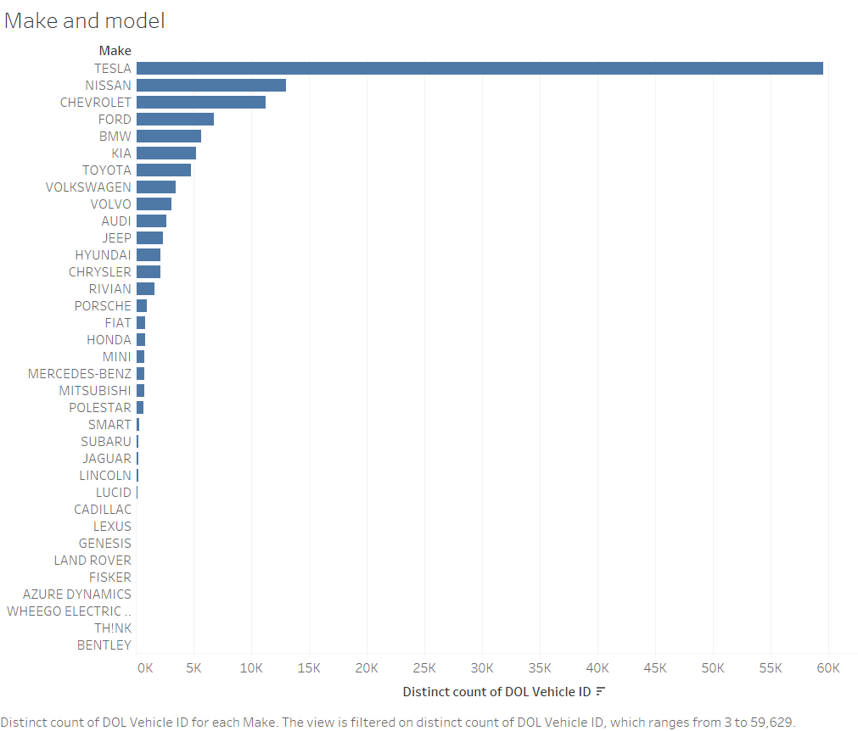

Slide 6
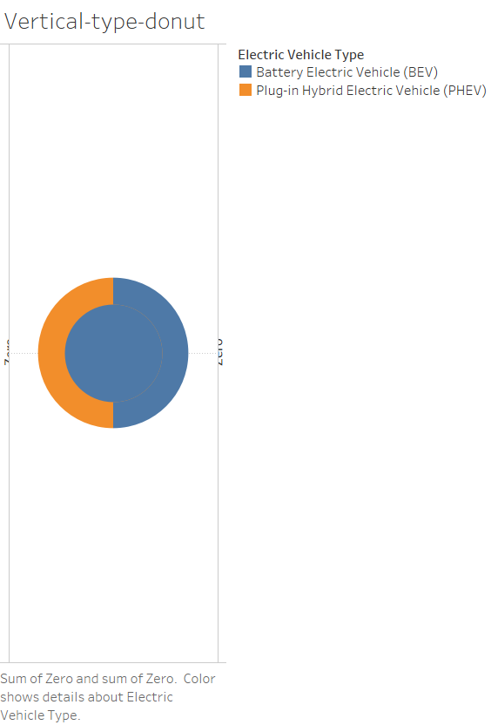

Slide 7
